Slide 1
Workshop Series
Tech 360 and 409
GeoMedia Spatial Data Warehousing
with Oracle
Chuck Woodbury
Consultant IMGS

Slide 2
Objective?
  Provide a high level overview of how GeoMedia works with the Oracle object Model

Slide 3
The END of the Relational Model
  Remember the Relational Model?
  With the release of Oracle 9i, Oracle is phasing out support of the relational model.
  GeoMedia will begin phasing it out as well. By GeoMedia Pro 6, you will have to make special requests for it.
  Now is the time to make the move! Is there any reason not to move to Object?

Slide 4
System Requirements
Oracle is an enterprise database…
Dedicated servers
Plenty of space
Plenty of Memory
Multi Processors
Notes:
MSSQL is actually more restrictive here and requires NT Server or Win 2000 Server.

Slide 5
Initialization Parameters I
Default initialization settings:
Initial Database
  Database Block Size 2K
  SGA Buffer Cache 64M
  SGA Shared Pool 64M
  SGA Redo Cache 4M
  Redo Log Files 4M
  Tablespaces Dictionary
Timing Results (baseline)
  Load Time (Seconds) 49.41
  Transactions / Second 8.152

Slide 6
Initialization Parameters II
Recommended minimum initialization settings:
Modified Database:
  Database Block Size 8K
  SGA Buffer Cache 128M
  SGA Shared Pool 128M
  SGA Redo Cache 16M
  Redo Log Files 16M
  Tablespaces Local
Timing Results
  Load Time (Seconds) 11.42
  Transactions / Second 10.683

Slide 7
Initialization Parameters III
  Buffer Cache – Caches data, make it large, but not to large as to use swap. It should be the largest component of SGA.
  Shared Pool – Caches SQL. Should be large but not necessarily as large as the Buffer.
  Redo Log Pool – Caches Redo information. Important if logging is turned on.
  There is a lot more to tuning than initialization.
  Real optimization will require database monitoring over time.

Slide 8
Oracle Spatial and Locator
  Oracle Spatial is a required component for Oracle 8i. With the release of Oracle 9i, the basic functionality required by GeoMedia can also be found in interMedia Locator.
  interMedia Locator is part of Oracle 9i SE and contains everything you need to set up and use as a GeoMedia warehouse.

Slide 9
What’s in Locator?
  Support for all geometry types: Points, point clusters, lines, line strings, compound line strings, polygons, polygons with holes, compound polygons, arc strings, circles, rectangles.
  Support for 2D, 3D, and 4D data
  R-tree and quadtree spatial indexing
  All spatial operators and the spatial distance function
  - SDO_FILTER
  - SDO_RELATE
  - SDO_NN
  - SDO_NN_DISTANCE
  - SDO_WITHIN_DISTANCE
  - SDO_GEOM.SDO_DISTANCE
  Functions to validate geometries to Oracle Spatial schema
  - SDO_GEOM.VALIDATE_GEOMETRY
  - SDO_GEOM.VALIDATE_LAYER

Slide 10
What’s missing from Locator?
  All spatial functions in SDO_GEOM package, except
  - SDO_GEOM.SDO_DISTANCE
  - SDO_GEOM.VALIDATE_GEOMETRY
  - SDO_GEOM.VALIDATE_LAYER
  Oracle Spatial includes functions for:
  - length/area calculations
  - buffer, centroid, convexhull
  - geometry intersection, union
  Spatial aggregate functions
  Set of tuning functions and procedures (SDO_TUNE package functions)
  Linear referencing support (SDO_LRS package functions)
  Coordinate System Functions

Slide 11
Which to use?
  Locator is not designed to be a solution for complex GIS applications. If advanced functionality such as comprehensive coordinate system support; linear referencing; spatial functions (e.g. area calculations, centroids, buffers); or spatial aggregate functions is required, users should deploy with Oracle Spatial on the Oracle Enterprise Edition.
  There are a lot of other reasons to stick with Oracle Enterprise. The choice is up to you. Compare and get what best suits your needs.

Slide 12
Patches and Updates
Oracle regularly releases patches:
  Current patch set for Oracle 8.1.7 is 8.1.7.3.1
  You should be running at least 8.1.7.2.1
  We are fully 9i compatible
  Patches regularly yield important bug fixes and performance improvements.
  They can be difficult to install, make sure you read the instructions! The spatial portion is often a separate component.
  With Release 2 of 9i, patches should be easier to install.

Slide 13
Enough of that!
Down to business…
What makes Oracle Spatial spatial?

Slide 14
Data Storage: SDO_GEOMETRY
Spatial uses a new database object called SDO_GEOMETRY
Oracle Spatial defines the object type SDO_GEOMETRY as:
CREATE TYPE SDO_GEOMETRY AS OBJECT (
SDO_GTYPE NUMBER,
SDO_SRID NUMBER,
SDO_POINT SDO_POINT_TYPE,
SDO_ELEM_INFO MDSYS.SDO_ELEM_INFO_ARRAY,
SDO_ORDINATES MDSYS.SDO_ORDINATE_ARRAY);

Slide 15
Data Storage (cont.)
A typical GEOMETRY column looks like the following:
GEOMETRY(SDO_GTYPE,
SDO_SRID,
SDO_POINT(X, Y, Z),
SDO_ELEM_INFO(OFFSET,ETYPE,INTERPRETATION)
SDO_ORDINATES(COORDINATE PAIRS))
For Example:
GEOMETRY(2002,
NULL,
NULL,
SDO_ELEM_INFO_ARRAY(1, 2, 1),
SDO_ORDINATE_ARRAY
(1794727.87, 857108.118,1799786.77, 866438.465))

Slide 16
Data Storage (cont.)
SDO_GTYPE
  d000 UNKNOWN_GEOMETRY Spatial ignores this geometry.
  d001 POINT Geometry contains one point.
  d002 LINESTRING Geometry contains one line string.
  d003 POLYGON Geometry contains one polygon with or without holes
  d004 COLLECTION Geometry is a heterogeneous collection of elements
  d005 MULTIPOINT Geometry has multiple points.
  d006 MULTILINESTRING Geometry has multiple line strings.
  d007 MULTIPOLYGON Geometry has multiple, disjoint polygons
  d indicates dimension 2 for 2D, 3 for 3D, 4 for LRS

Slide 17
Data Storage (cont.)
SDO_SRID
This attribute is intended to be a foreign key in a spatial reference system definition table. GeoMedia does not use this and the value is typically NULL.
SDO_POINT
SDO_POINT is defined using an object type with attributes X, Y, and Z, all of type NUMBER. This is how Oracle stores Native Point Geometry. GeoMedia uses Oriented Point Geometry and thus does not make use of this field. It typically will be NULL in GeoMedia schemas.

Slide 18
Data Storage (cont.)
SDO_ELEM_INFO array
This ARRAY is defined as a varying length of numbers, in the form of triplets, that describes how to interpret the ordinates stored in the SDO_ORDINATES array. Each group of values, or triplets, are interpreted as follows:
    OFFSET -- Indicates the offset within the SDO_ORDINATES array where the first ordinate for this element is stored. Offset values start at 1 , thus, the first ordinate for the first element will be at SDO_GEOMETRY.SDO_ORDINATES(1).
    ETYPE - Indicates the type of the element. Valid values are 0 through 5, as well as the following: 1003 and 2003 (variants of 3), and 1005 and 2005 (variants of 5). ETYPE values 1, 2, and 3 are considered simple elements. They are defined by a single triplet entry in the SDO_ELEM_INFO array.
    INTERPRETATION - Means one of two things, depending on whether or not the ETYPE is a compound element.

Slide 19
Data Storage (cont.)
SDO_ORDINATE array
This array is defined using a varying length (1048576) of type NUMBER that stores the coordinate values that make up the boundary of a spatial object. This array must always be used in conjunction with the SDO_ELEM_INFO array. The values in the array are ordered by dimension.
For example, a polygon whose boundary has four 2-dimensional points is stored as:
{X1, Y1, X2, Y2, X3, Y3, X4, Y4, X1, Y1}.
If the points are 3-dimensional, then they are stored as:
{X1, Y1, Z1, X2, Y2, Z2, X3, Y3, Z3, X4, Y4, Z4, X1, Y1, Z1}.

Slide 20
Data Storage
Example 1: Points
Native Point Features
GEOMETRY(2001, NULL,
SDO_POINT(2059713.23, 1058581.25),NULL,NULL)
GeoMedia Oriented Point Features**
GEOMETRY(2001, NULL, NULL,
SDO_ELEM_INFO_ARRAY(1, 0, 6000, 4, 1, 1),
SDO_ORDINATE_ARRAY(1, 0, 0, 2059713.23, 1058581.25))
1,0,6000 tells Oracle to ignore this element, it is user defined. GeoMedia uses the first 3 values in the ordinate array to define the rotation matrix.
4,1,1 tells Oracle that the 4th ordinate begins a simple point feature.
**By default, GeoMedia will always use the oriented point feature format.

Slide 21

Data Storage
Example 2: Linear Features
Simple Line:
GEOMETRY(2002, NULL, NULL,
SDO_ELEM_INFO_ARRAY(1, 2, 1),
SDO_ORDINATE_ARRAY
(1794727.87, 857108.118, 1799786.77, 866438.465))
1,2,1 indicates a simple line starting at ordinate 1
Complex Line:
GEOMETRY(2002, NULL, NULL,
SDO_ELEM_INFO_ARRAY(1, 2,1,3,2,2),
SDO_ORDINATE_ARRAY
(1794727.87, 857108.118, 1799786.77, 866438.465,
1564727.87, 867908.118, 1559786.77, 843438.465))
1,2,1 indicates a simple line at ordinate 1 and 3,2,2 indicates an arc
beginning at ordinate 3

Slide 22
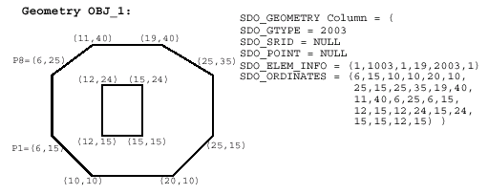
Data Storage
Example 3: Polygons and Holes
  In SDO_ELEM_INFO, there are two triplet : 1,1003,1 and 19,2003,1. 1003 indicates that the element is an exterior polygon; 2003 indicates that the element is an interior polygon (hole).
  In SDO_ELEM_INFO, 19 indicates that the second element (the hole) ordinate specification starts at the 19th number in the SDO_ORDINATES array (the first point is 12,15).
  Exterior polygons are written counter-clockwise while interior holes are written clockwise.
Notes:
Need more examples

Slide 23
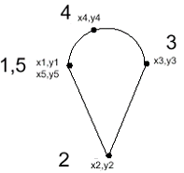
Data Storage
Example 4: Complex Polygons
GEOMETRY(2003, NULL, NULL,
SDO_ELEM_INFO_ARRAY(1,1005,2,1,2,1,5,2,2)
SDO_ORDINATE_ARRAY (x1,y1,x2,y2,x3,y3,x4,y4,x5,y5,x1,y1) )
  The first triplet indicates that this element is a compound line string made up of two line strings, which are described using the next two triplets.
  The second triplet indicates that the line string is made up of straight line segments and that the ordinates for this line string start at offset 1.
  The third triplet indicates that the second line string is made up of circular arcs with ordinates starting at offset 5. The end point of this line string is determined by the starting offset of the next element.

Slide 24
Data Storage - Text
Oracle Spatial currently does not support text!
  GeoMedia V4 stores text in a BLOB called offset.. No way to spatially index this so performance suffers.
  GeoMedia V5 uses a a new mechanism to store text. Text will be stored as a point feature so indexing can be used.

Slide 25
Data Storage
Example 5: Text
With the release of GeoMedia Professional 5.0, text is now stored as an oriented point feature with some additional information that contains text orientation, alignment, format, and the actual text.
  SDO_GEOMETRY (3001, NULL, NULL,
  SDO_ELEM_INFO_ARRAY (1, 0, 6001, 9, 1, 1),
  SDO_ORDINATE_ARRAY (0, 0, 0,
  1, 65536, 7, 1650551873, 6384993, 861906.95, -482832.23, 0))
In the ELEM_INFO_ARRAY, the triplet 1,0,6001 describes a user defined ETYPE (0) with an INTERPRETATION (6001) which GeoMedia interprets as its text format. The triplet 9,1,1 describes the location of the text as a point feature at OFFSET 9.
In the ORDINATE_ARRAY, the first value contains the the rotation matrix; the next three values (0,0,1) represent the normal vector. The fifth value (in this case, 65536) is an integer representation of the format and alignment of the text. The sixth value, in this case 7, is the number of characters of text being stored (including spaces). This is followed by integer representations of the actual text where each integer decomposes into 4 bytes of text.

Slide 26
Data Storage - Raster
GeoMedia has long used it own format to store Raster Image information.!
  GeoMedia V4 stores raster image location and other pertinent information in a in a BLOB. As with text, there was no way to spatially index this so performance suffers.
  GeoMedia V5 uses a a new mechanism to store the raster information. The extents of the raster images will now be stored as polygons along with other pertinent information related to the display of the image.

Slide 27
Data Storage
Example 6: Raster
With the release of GeoMedia Pro 5.0, raster images are now stored as polygon features with some additional information that stores the display matrix and the filename. The actual raster image is not stored in the database; only the image header information and the filename are stored along with the MBR of the image.
  SDO_GEOMETRY (2003, NULL, NULL,
  SDO_ELEM_INFO_ARRAY (1, 0, 6002, 22, 2003, 1),
  SDO_ORDINATE_ARRAY
  (112.3,15452.2,15781.3,5124.3,
  112.3,15452.2,15781.3,5124.3,112.3,15452.2,15781.3,
  112.3,15452.2,15781.3,5124.3,112.3,15452.2,
  27,1242134123,134123411,13412341234,13241234123,
  1000,1000,1000,10000,10000,10000,10000,1000,1000,1000))

Slide 28
Data Storage
Example 6: Raster (cont.)
  The ELEM_INFO_ARRAY triplet (1,0,6002) contains a user defined ETYPE of 0 with an INTERPRETATION of 6002. This tells GeoMedia that the values it is reading correspond to a raster image. The second triplet (22,2003,1) represents the polygonal outline of the raster image. Only the OFFSET value, 22, may vary.
  The first 16 values in the ORDINATE_ARRAY store the display matrix for the raster image. The 18th value stores the length of the filename. The integers following the length are the actual file name decomposed into 4 byte integers. The number of integers used will depend on the length of the filename. This is followed by the 5 coordinate pairs that make up the polygonal outline of the raster image.
  By treating the raster image outline as a polygon feature, GeoMedia can make full use of Oracle’s spatial filtering capability. Since the raster image is treated a polygon, entries are required in the USER_SDO_GEOM_METADATA as well as in the GDOSYS metadata. Either a Quad Tree or an R-Tree spatial index is also required.

Slide 29
GeoMedia Requirements
Read-Only vs. Read-Write
Read-Only access – no metadata requirements
  If you are working without metadata, the GeoWorkspace must be assigned a coordinate system that matches the feature class that is being displayed
Read-Write access – GDOSYS is required.
  Once a GDOSYS schema exists, it will be used for all native spatial object schemas in the database.
  Normally, access to the GDOSYS schema is granted to public .
  To isolate access to GDOSYS, revoke the public privileges and explicitly grant select, insert, update, and delete on GDOSYS to those spatial users requiring it

Slide 30
Metadata Requirements
Oracle Metadata –
USER_SDO_GEOM_METADATA (view)
  This is an MDSYS view that is accessible to any user containing SDO_GEOMETRY columns
  This view contains the extents of the geometry contained by a layer or table. It is required for spatial indexing.
GeoMedia Metadata –
GDOSYS (schema)
  Separate schema containing metadata tables
  These tables contain entries for all GeoMedia enabled features in any schema in the database instance.
Notes:
GeoMedia Metadata is not required for read-only connections, however, if it exists, it must be used.

Slide 31
Metadata Requirements - USER_SDO_GEOM_METADATA
  Must be populated for spatial indexes to work
  GeoMedia automatically supplies default values
  Defaults need to be updated to reflect true extents of feature. You can use the following sql command to calculate the actual extents:
    SELECT SDO_TUNE.EXTENT_OF('&layer','&geom') MBR
    FROM DUAL;
  And use this sql command to insert new values:
  INSERT INTO USER_SDO_GEOM_METADATA VALUES
  ('&layer','&geom', MDSYS.SDO_DIM_ARRAY(
  MDSYS.SDO_DIM_ELEMENT('X',&xmin, &xmax, 0.000005),
  MDSYS.SDO_DIM_ELEMENT('Y',&ymin, &ymax, 0.000005)),
  NULL);

Slide 32
Metadata Requirements – GDOSYS
  Should be created by SYSTEM DBA
  May be created using Database Utilities or via the Import script provided by Export to OOM
  Created in the System tablespace by default, can be created in any tablespace
  Starting with GeoMedia Pro 5, a SQL script will be delivered that can be used to create GDOSYS
  GeoMedia automatically populates the default values and Database Utilities can be used to change/modify or insert new values.
  By default, select, insert, update, and delete granted to public.

Slide 33
GDOSYS Tables
ATTRIBUTEPROPERTIES
FIELDLOOKUP
GALIASTABLE
GCOORDSYSTEM
GEOMETRYPROPERTIES
GFEATURES
GFIELDMAPPING
GPARAMETERS
MODIFIEDTABLES
MODIFICATIONLOG
+ any other tables required by the industry applications

Slide 34
Other GDOSYS Objects
The following sequences are required:
GMODLOG
GAUTONUMBERSEQUENCE
FIELDLOOKUPINDEXID1
The following trigger is required:
DELETEMETADATAGMT

Slide 35
GDOSYS’s Table Relationships
The metadata tables in the GDOSYS schema are related to each other in specific ways. Direct relationships are listed as follows:
GCOORDSYSTEM.CSGUID = GFIELDMAPPING.CSGUID =
GEOMETRYPROPERTIES.GCOORDSYSTEMGUID
GEOMETRYPROPERTIES.INDEXID =
ATTRIBUTEPROPERTIES.INDEXID = FIELDLOOKUP.INDEXID
FIELDLOOKUP.FEATURENAME = GFEATURES.FEATURENAME
The following are indirect and implied relationships:
The OWNER/TABLE_NAME in the GFIELDMAPPING table corresponds to the FEATURENAME column in the client metadata tables (FIELDLOOKUP and GFEATURES).
The COLUMN_NAME in the GFIELDMAPPING table corresponds to the FIELDNAME column in the client metadata tables.

Slide 36
Things to remember about GDOSYS….
  DO NOT manually edit it unless you know what you are doing.
  Always works with a copy and test any changes
  Use Database Utilities to edit the metadata, that is what it is for.
  Stores the coordinate system for each feature class in every schema.

Slide 37
Loading Data into OOM
There are several ways to load data:
  Directly inserting data using SQL
  Bulk loading using SQL*Loader
  Using GeoMedia…
    Export to Oracle Object
    Import from Warehouse
    Output to Feature Class
  3rd Party Tools like FME

Slide 38
What’s the best method to migrate data?
Use Oracle’s own tools for…
  Raw data – SQL Loader…
Use GeoMedia Pro’s tools for…
  Existing GIS data – Export to OOM
  Small GIS datasets – Import from Warehouse
  Single feature class – Output to Feature Class
3rd Party Tools?
  Large scale schema changes and data manipulation

Slide 39
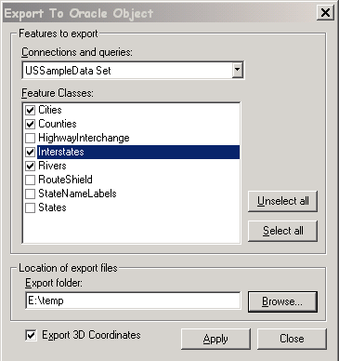
Export to Oracle Object
Export to Oracle Object
Generates text files that utilize Oracle’s SQL Loader
  Import.bat
  Metadata.sql
  Feature1.pre
  Feature1.ctl
  Feature1.dat
  Feature1.pos
CMD Syntax:
import user/pswd@server
GDOSYS metadata should have been previously created.

Slide 40
Export to OOM - Caveats
  There is no error reporting during the process, it will run to completion. Check the export.log file for any errors that may have occurred and to verify the features exported.
  During import, a log file is generated for each feature.
  Watch out for reserved words particularly when importing from CAD, MAPINFO, or Access.
  For OOM, never use the Y option. GDOSYS should already be there.
  Each Run should use its own directory to store output or you will overwrite the import.bat file
  Workspace Coordinate System is used for all the features exported

Slide 41
Setting Oracle’s Metadata
Both Oracle and GeoMedia require the presence of Oracle metadata.
  The metadata needs to be optimized for each feature class’s extents.
  Extents can be calculated but default extents are still required.
  The following will insert default extents:
  INSERT INTO USER_SDO_GEOM_METADATA VALUES
  (‘STATES’,’GEOMETRY’,MDSYS.SDO_DIM_ARRAY(
  MDSYS.SDO_DIM_ELEMENT
  ('X',-2147483648, 2147483647, 0.000005),
  MDSYS.SDO_DIM_ELEMENT
  ('Y',-2147483648, 2147483647, 0.000005),
  MDSYS.SDO_DIM_ELEMENT
  ('Z',-100000, 100000, 0.000005)),NULL);

Slide 42
Calculating Actual Extents
Two command are available depending whether you are using 8i or 9i. Neither are available in locator:
  For 8i:
  SELECT SDO_TUNE.EXTENT_OF(‘FC’,’GEOMETRY’) FROM DUAL;
  For 9i:
  SELECT SDO_AGGR_MBR(‘GEOMETRY_COLUMN’) FROM TABLE_NAME;

Slide 43
Data Validation and Repair
In order to perform spatial indexing, the data must be valid. Oracle Spatial supplies functions to check the validity of the data prior to indexing:
  SDO_GEOM.VALIDATE_GEOMETRY (a function)
  Determines if a geometry is valid.
  SDO_GEOM.VALIDATE_LAYER (a procedure)
  Determines if all the geometries stored in a column are valid.

Slide 44
VALIDATE_GEOMETRY
Performs a consistency check for valid geometry types. The function checks the representation of the geometry against the element definitions.
SDO_GEOM.VALIDATE_GEOMETRY(
theGeometry IN MDSYS.SDO_GEOMETRY,
theDimInfo IN MDSYS.SDO_DIM_ARRAY
) RETURN VARCHAR2;
or
SDO_GEOM.VALIDATE_GEOMETRY(
theGeometry IN MDSYS.SDO_GEOMETRY,
tolerance IN NUMBER
) RETURN VARCHAR2;
Returns TRUE if the geometry is Valid and either FALSE or a specific Oracle error number is the geometry is invalid.

Slide 45
What does Validate Geometry check?
For type consistency, the function checks for the following:
  The SDO_GTYPE is valid.
  The SDO_ETYPE values are consistent with the SDO_GTYPE value. For example, if the SDO_GTYPE is 2003, there should be at least one element of type POLYGON in the geometry.
  The SDO_ELEM_INFO_ARRAY has valid triplet values.

Slide 46
What else does Validate Geometry check?
For geometry consistency, the function checks for the following::
  Polygons have at least four points, which includes the point that closes the polygon. (The last point is the same as the first.)
  Polygons are not self-crossing.
  Point redundancy.
  Correct orientation - Exterior ring boundaries must be oriented counterclockwise, and interior ring boundaries must be oriented clockwise.
  An interior polygon ring touches the exterior polygon ring at no more than one point.
  If two or more interior polygon rings are in an exterior polygon ring, the interior polygon rings touch at no more than one point.
  Line strings have at least two points.
  Points on an arc are not co-linear
  Geometries are within the specified bounds of the applicable DIMINFO column value (from the USER_SDO_GEOM_METADATA view).

Slide 47
VALIDATE_LAYER
Examines a geometry column to determine if the stored geometries follow the defined rules for geometry objects:
SDO_GEOM.VALIDATE_LAYER(
geom_table IN VARCHAR2,
geom_column IN VARCHAR2,
pkey_column IN VARCHAR2,
result_table IN VARCHAR2);
Results are loaded into a results table:
CREATE TABLE val_results (pid number, result varchar2(10));
PID contains the primary key of the row in error and RESULT contains the error code.

Slide 48
What does Validate layer check for?
  All the type consistency and geometry consistency checks that are performed by the SDO_GEOM.VALIDATE_GEOMETRY function.
  It also checks for valid SRID’s and GTYPES

Slide 49
So which one do you use?
  Use Validate Geometry for quick checks
  Use Validate Layer if you want to actually correct the data.
    Validate layer lets you identify the specific row that is bad
    It also tells you what is wrong with the data (in most cases).

Slide 50
Spatial Indexing/Tuning
  Spatial Indexes
    Fixed Quad Tree Indexes
    Hybrid Quad Tree Indexes
    R-Tree Indexes
  Estimating Tiling Levels
  Updating Existing Indexes
  Oracle’s Spatial Index Advisor

Slide 51
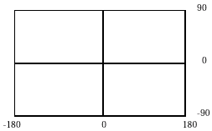
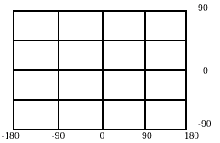
Spatial Indexing/Tuning
Fixed Indexes
  Fixed Indexing divides the extents of the feature into fixed size tiles in a process called tessellation.
  The level of tessellation determines the size and total number of tiles.
  Increasing the level results in smaller size tiles and better geometry approximations.
  Syntax:
  CREATE INDEX ROADS_FIXED ON
  ROADS(GEOMETRY) INDEXTYPE IS
  MDSYS.SPATIAL_INDEX
  PARAMETERS(’SDO_LEVEL=8’);

Slide 52
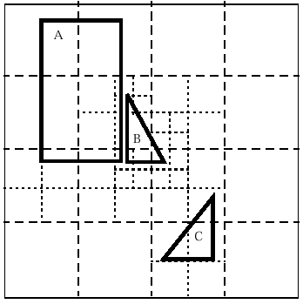
Spatial Indexing/Tuning
Hybrid Indexes
  Hybrid indexing uses both fixed and variable sized tiles as the indexing method.
  Fixed tiling approximates the entire area while variable sized tiles cover areas with a high density of data. The result is a more efficient use of index space.
  To use hybrid tiling, the SDO_LEVEL and SDO_NUMTILES keywords in the PARAMETERS clause:
    The SDO_LEVEL value determines the size of the fixed tiles
    The SDO_NUMTILES value determines the number of variable tiles that will be used.
  Syntax:
    CREATE INDEX ROADS_HYBRID ON ROADS(GEOMETRY) INDEXTYPE IS MDSYS.SPATIAL_INDEX PARAMETERS(’SDO_LEVEL=6 SDO_NUMTILES=12’);

Slide 53
Spatial Indexing/Tuning
Hybrid versus Fixed
Under most circumstances, Oracle recommends using fixed indexes for spatial data. Use Hybrids in the following situations:
  When joins are required between layers whose optimal fixed index level values are significantly different (4 levels or more).
  When both of the following are true for a single layer:
    The layer has a mixture of many geometries covering a very small area and many polygons covering a very large area.
    The optimal fixed tiling level for the very small geometries will result in an extremely large number of tiles to be generated for the very large geometries, causing the spatial index to grow to an unreasonable size.

Slide 54
Spatial Indexing/Tuning
R-Tree Indexes
With the release of Oracle 8i/9i, RTrees are the preferred method of spatial indexing.
  They are faster than Quad Trees
  They are easier to generate
  The syntax is simpler
  They don’t require precise extents. Global extents work just fine.
  Syntax:
  CREATE INDEX index_name ON table_name(geom_col) INDEXTYPE IS MDSYS.SPATIAL_INDEX ;
Notes:
GeoMedia is currently not completely compatible with R-Trees. By the release of Oracle 9i and GeoMedia 5, R-Trees will become the de-facto indexing method.

Slide 55
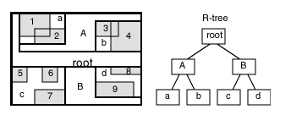
Spatial Indexing/Tuning
R-Tree Indexes (cont.)
An R-tree index approximates each stored geometry by a minimum bounding rectangle, or MBR. For any given feature class (or layer), an R-tree index consists of a hierarchical index on the MBR’s of the geometries in the feature class.
Notes:
GeoMedia is currently not completely compatible with R-Trees. By the release of Oracle 9i and GeoMedia 5, R-Trees will become the de-facto indexing method.

Slide 56
Spatial Indexing/Tuning
R-Tree Indexes (cont.)
RTree Requirements:
  Large Rollback Segment - 100*n bytes, where n is the number of rows of data to be indexed.
  Large Sort Area Size - The SORT_AREA_SIZE value is the maximum amount, in bytes, of memory to use for a sort operation. Use the following to change the sort are prior to creating an index:
  ALTER SESSION SET SORT_AREA_SIZE = 20000000;
Notes:
GeoMedia is currently not completely compatible with R-Trees. By the release of Oracle 9i and GeoMedia 5, R-Trees will become the de-facto indexing method.

Slide 57
Spatial Indexing/Tuning
R-Tree Indexes (cont.)
RTree indexes operate in 3 dimensions. You can assign 2D RTrees indexes to 3D data but if you use true 3D RTrees, you need to pass a filter volume rather than a filter area. GeoMedia currently only supports the ability to pass 2D filter areas. If your data is indexed in 3D, only geometries with a Z value of zero will be returned.

Slide 58
Spatial Indexing/Tuning
What is the best method to use?
  RTrees work best on static data but do allow for editing. Indexes need to be re-generated more often
  Default extents can be used with RTrees
  Quad trees regenerate themselves when edited but are harder to set up.
  Quad trees require calculation of optimal extents.
  Violation of optimal extents can require the regeneration of the quad tree index.

Slide 59
Spatial Indexing/Tuning
Data Validation Revisited
Tuning requires clean geometry. Before spatially indexing your data, you need to ensure its validity. Oracle Spatial has built in commands for verifying both the geometry as a whole and the individual elements.
  NULL SDO_ORDINATE arrays are not allowed.
  Polygon boundaries must be in the right order.
  Polygons must close.
  Dimensions must be valid as specified.
  Data must be contained by specified extents.

Slide 60
Spatial Indexing/Tuning
Estimating Tiling Levels
Oracle provides built in commands to estimate the tiling levels for both fixed and hybrid indexing.
  For Fixed Indexing, use Spatial Index Advisor or the following syntax in SQL:
  SELECT SDO_TUNE.ESTIMATE_TILING_LEVEL(‘FEATUE’, ‘GEOMETRY’, 10000, ’ALL_GID_EXTENT’) SDO_LEVEL FROM DUAL;
  The result is a polygon.
  For Hybrid Indexing, use Spatial Index Advisor
R-TREES are handled differently and estimates are not needed.

Slide 61
Spatial Indexing/Tuning
Updating Existing Indexes
  GeoMedia automatically maintains both fixed and hybrid indexes as new data is added to the geometry.
  This occurs as long as the data resides within the extents specified in USER_SDO_GEOM_METADATA
  If new data exceeds the defined extents, the extents will have to be updated and the indexes will have to be dropped and re-created.

Slide 62
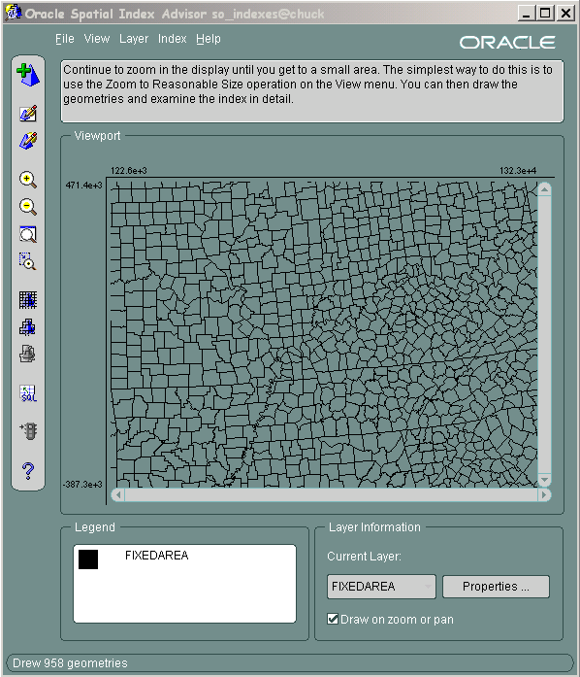
Spatial Indexing/Tuning
Oracle’s Spatial Index Advisor
The Spatial Index Advisor application helps database administrators to analyze and tune Oracle Spatial indexes, to achieve good performance for spatial queries. The application lets you analyze layers of spatial data (type SDO_GEOMETRY). The data represents objects such as rectangles, circles, polygons, and arcs, all of which are displayed graphically.

Slide 63
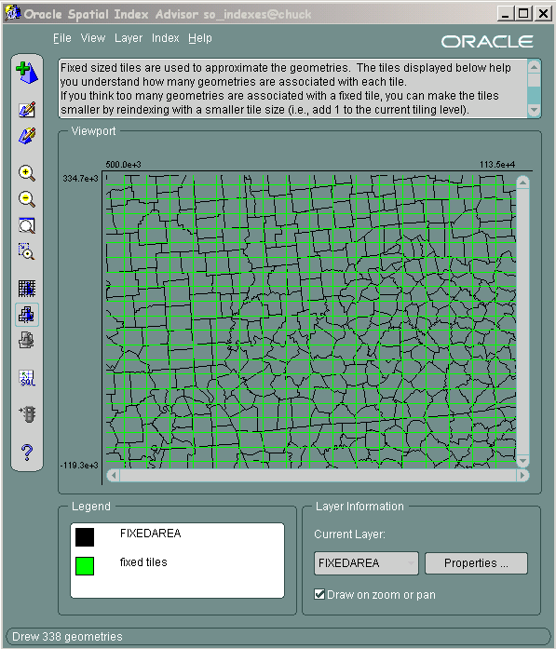
Spatial Indexing/Tuning
Oracle’s Spatial Index Advisor
  Requires the SELECT_CATALOG_ROLE
  Allows you to estimate and create spatial indexes for various features.
  Allows you to visualize the tessellation tiles.
  Allows you to try out various indexing scenarios.
  Allows you to update and modify existing spatial filters.

Slide 64
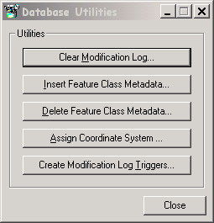
Database Utilities
GeoMedia Professional delivers Database Utilities. This is a collection of useful tools that perform specific operations depending on the database you are connected to.
  Clear Modification Log
  Insert Feature Class
  Delete Feature Class
  Assign Coordinate System
  Create Modification Log Triggers

Slide 65
What’s Supported/What’s Not!
  Grants are supported.
  Synonyms are not supported (well…)
  Views are supported – with caveats
  Join-Views are supported – with caveats
  Database links are not supported (use synonyms)
  Default Values are supported - with caveats
  Multiple Primary Key columns are allowed (Nuts!)

Slide 66
Working with Views and Join-Views
  How can I use Views and Join-Views?
    They are fully supported. GeoMedia treats them as any other feature class with some caveats.

Slide 67
Working with Views and Join-Views
  Can I update through a view ?
  You can do this if
    Your view is a simple subset of a single table.
    All "not null" columns for the table must be in the view.
    The primary key is in the view (key preserved)
    No updates are allowed in join-views (not in GeoMedia Pro)

Slide 68
Notification Issues with Views
Are there any specific issues with views?
NOTIFICATION! What is that?
  Use Modifcation Log Triggers
  2-Way notification does not work

Slide 69
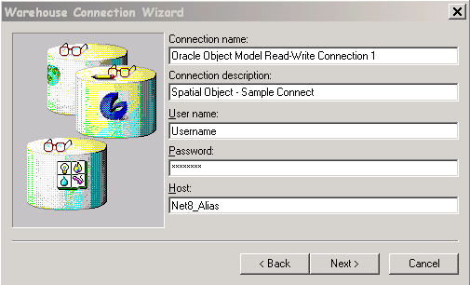
GeoMedia Connections to OOM
  Oracle Client is required
  Use Net 8 to create a connection alias. This is your host name.
  Connect to Oracle using a standard Oracle user and password.
  Domain Authentication is supported - /@server

Slide 70
Pros and Cons – Oracle
Pros –
  Multithreaded
  Well established
  Exposed geometry format
  Numerous native spatial commands
  Server side processing
  High spatial filter performance
  Support for other Oracle packages e.g. OWM
  Runs on many platforms
Cons –
  Expensive
  Complex
  Requires training
  Can be overwhelming
  Unforgiving of poor data
  Performance Issues on full data retrieval

Slide 71
Interested in More?
Check out Tech 361 for a Hands On Workshop that will cover the following:
  1. Bulk Export a Feature Class
  2. Import it to OOM
  3. Assign Oracle Metadata
  4. Spatially Index the Feature
  5. Assign GeoMedia Metadata via Database Utilities
  6. Display in GeoMedia
  Spatially Filter the Data
  No Lecture this time…promise!

Slide 72
That’s a Wrap!
Questions or Comments?
Thank you for attending
and enjoy your stay in Atlanta

